Slide 1
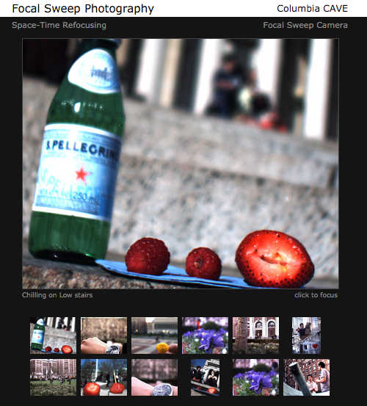
Focal Stack Viewer
Search keywords: focal sweep photography
URL: http://www.cs.columbia.edu/CAVE/projects/focalsweep/

Slide 2
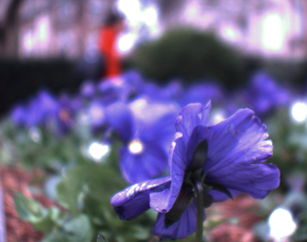

Conventional vs. Focal Sweep Photography
Photograph
Focal Stack (played in loop)

Slide 3
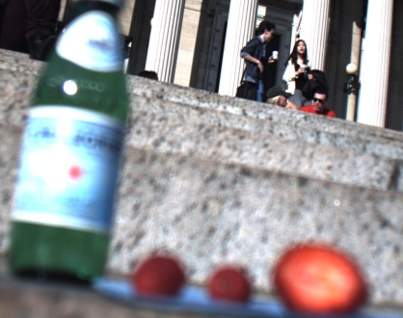
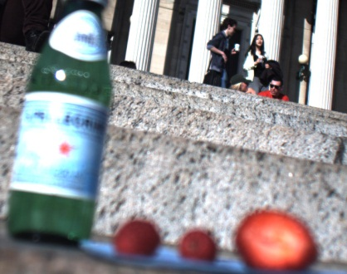

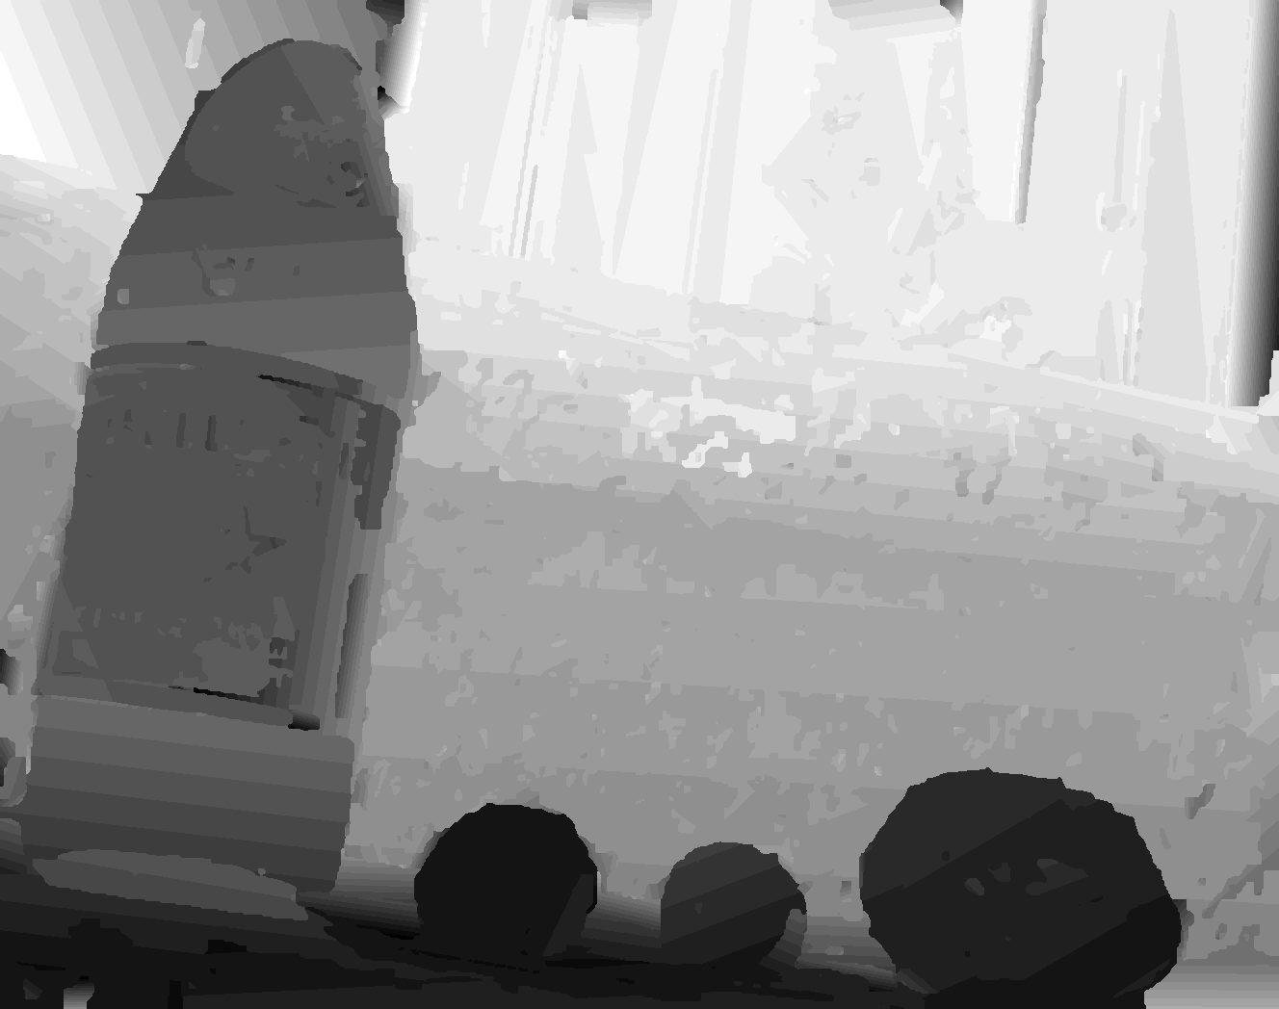
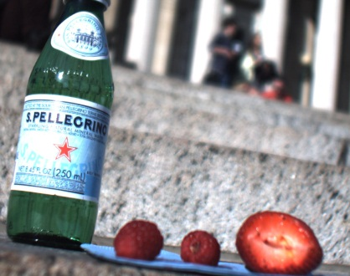

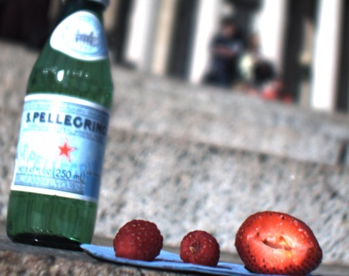

Refocusing
Focal Stack
Space-Time In-focus Index Map

Slide 4

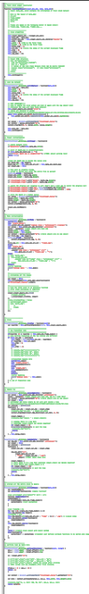
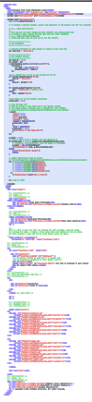

Slide 5

1.
2.
Active (canvas)
3.
Hidden (canvas)

